Slide 1

IoT Fleet Management with balenaCloud

Slide 2
A Quick Tour

Slide 3
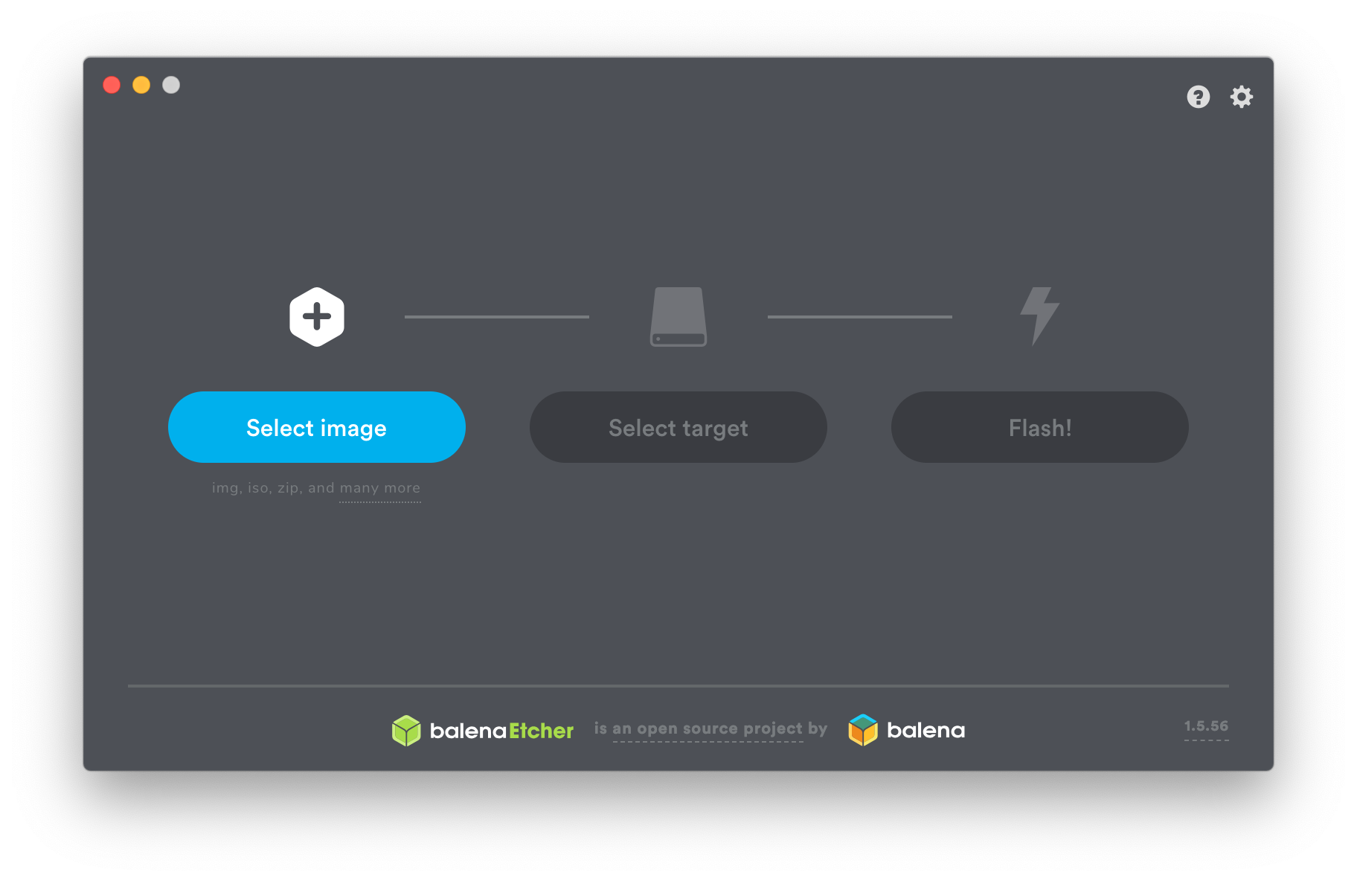
Notes:
I suspect there are some Etcher users in the audience.

Slide 4
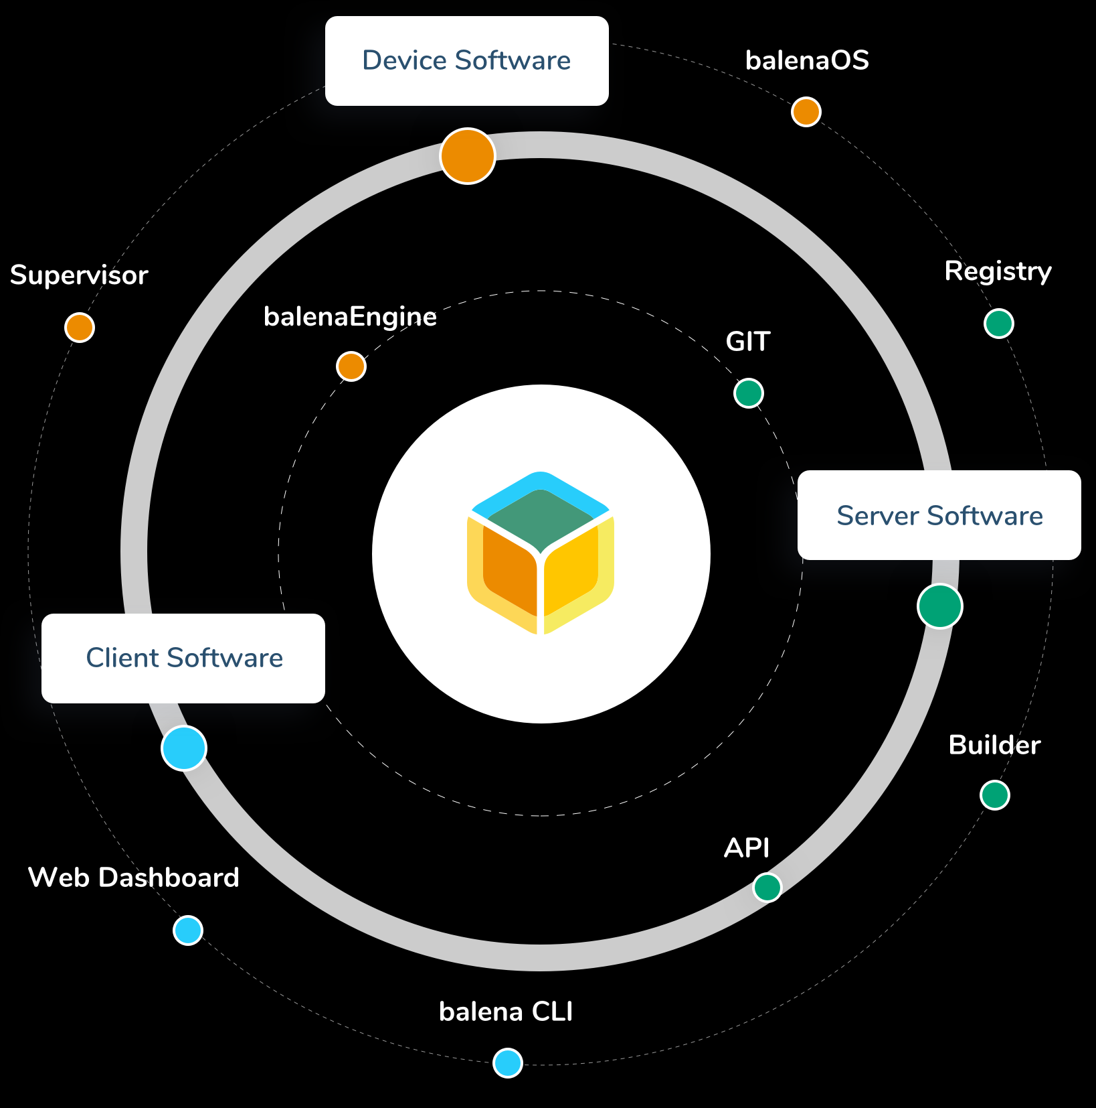
The Balena Ecosystem is Much More...
balenaCloud
balenaHub
balenaFin
EtcherPro
openBalena
balenaEngine
balenaOS
balenaLabs

Slide 5
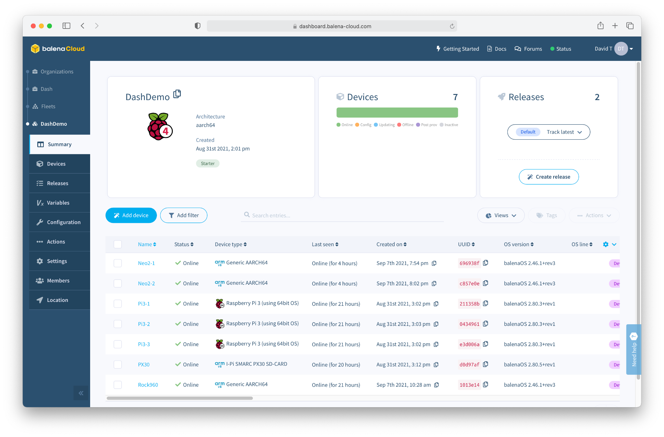
balenaCloud
“Platform built to develop, deploy, and manage fleets of connected devices at scale.”

Slide 6
What do we mean by IoT “Fleet Management”?

Slide 7
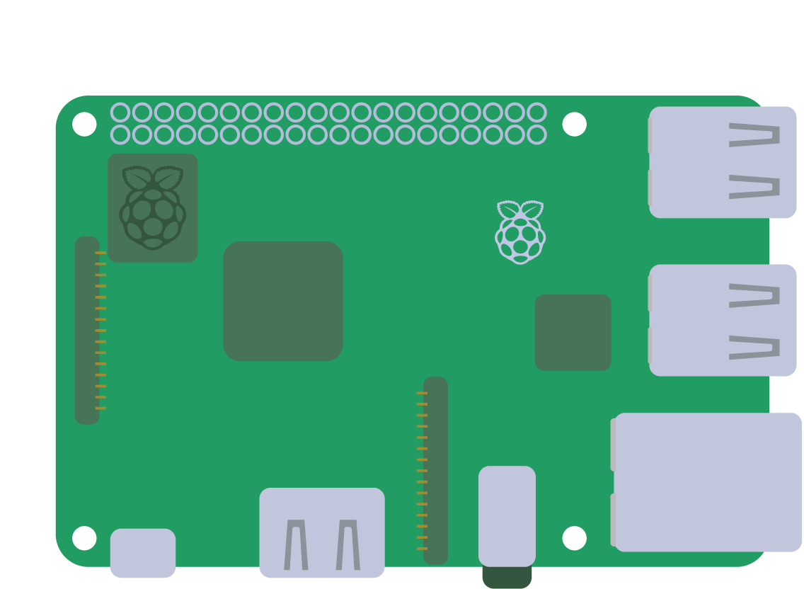


Slide 8
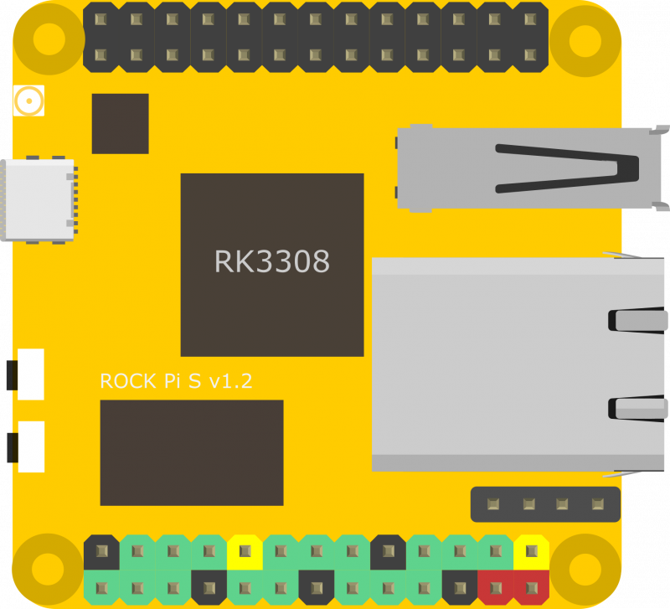
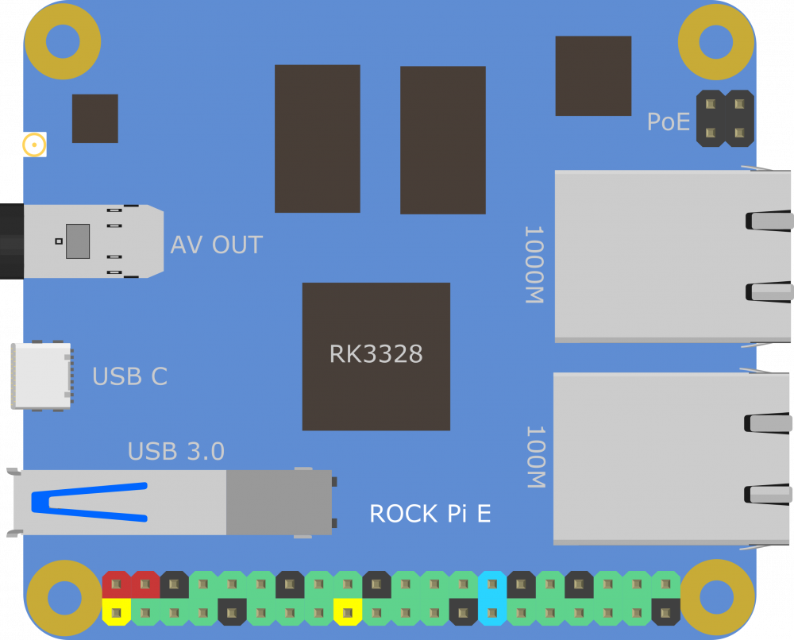
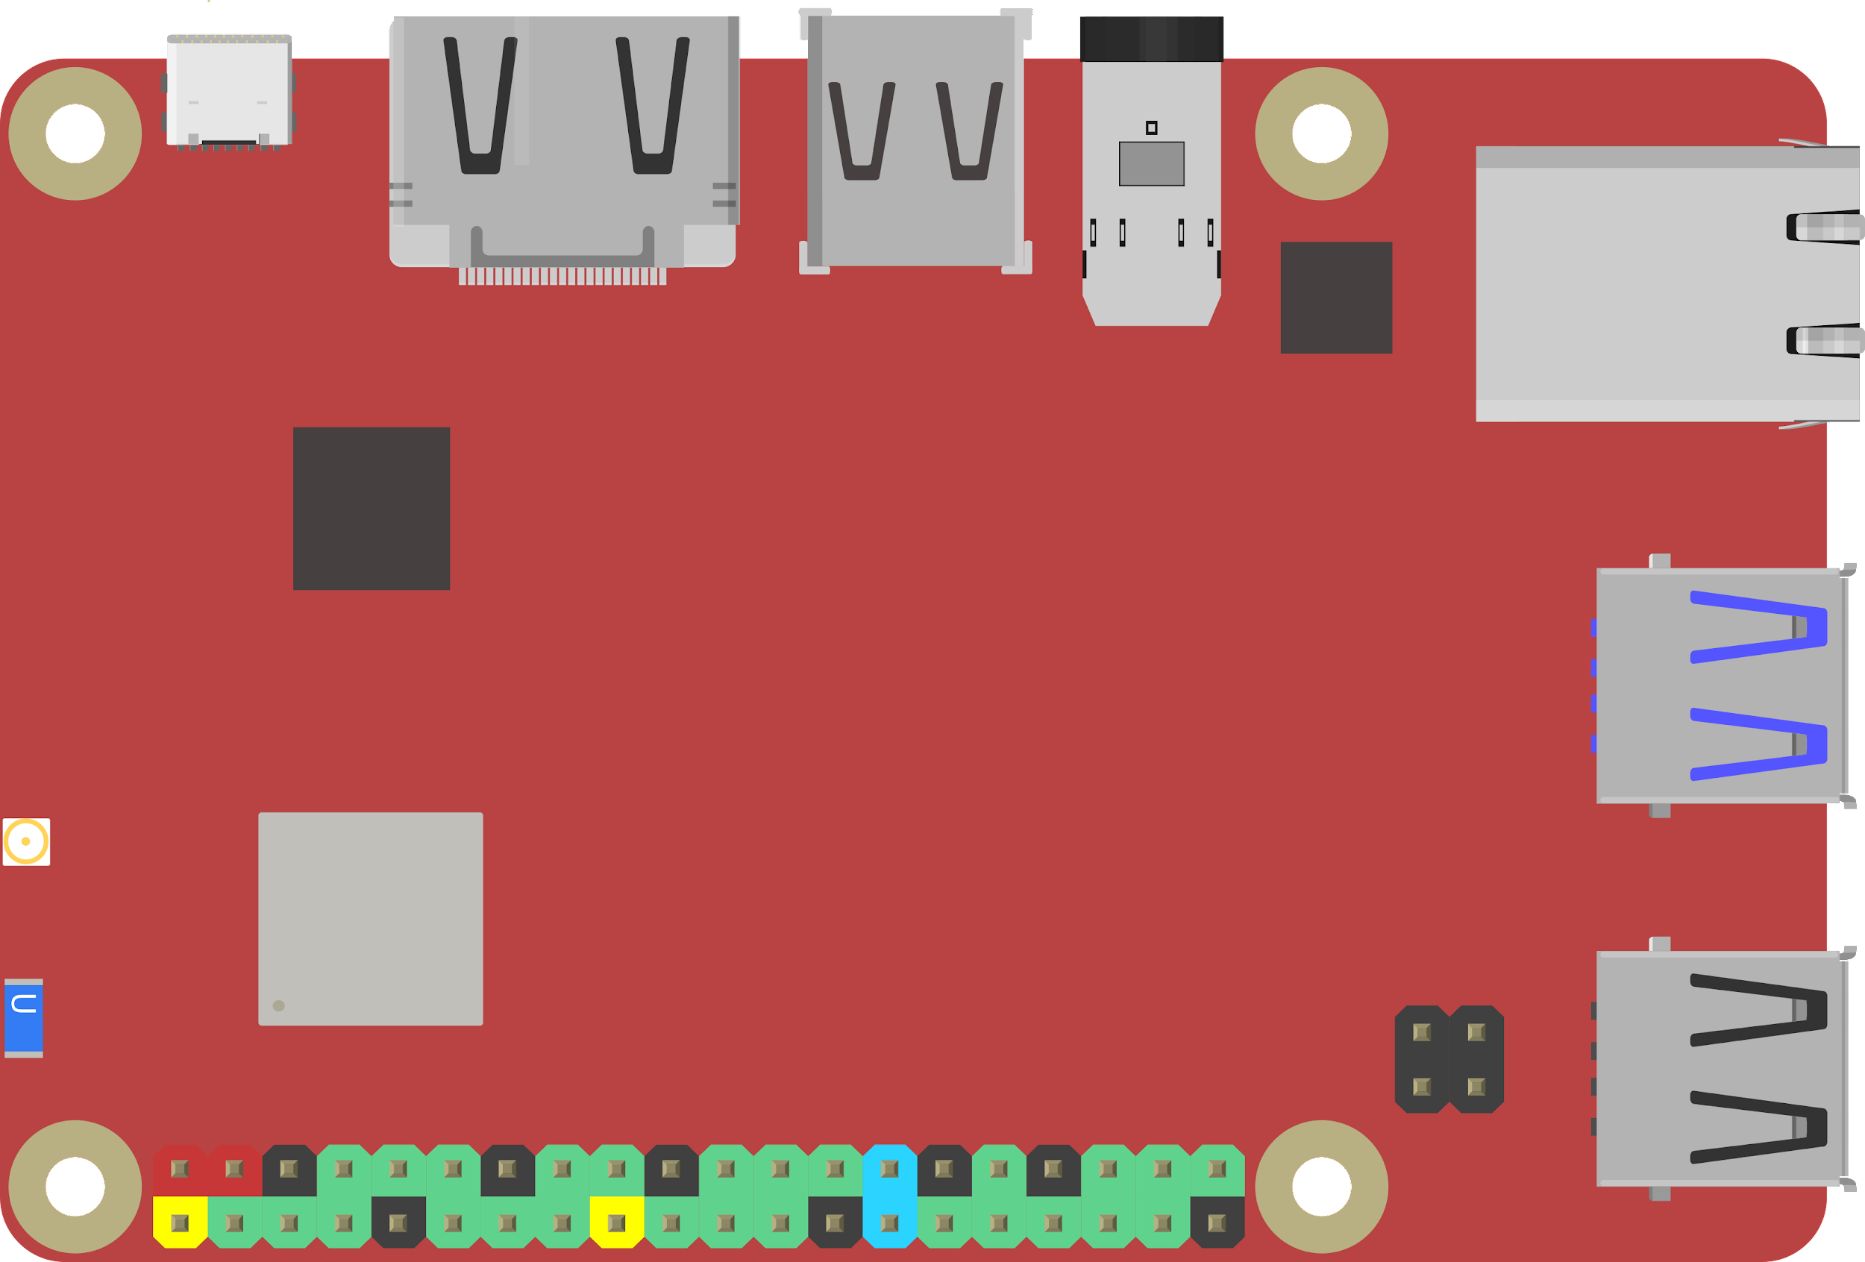
Notes:
48

Slide 10
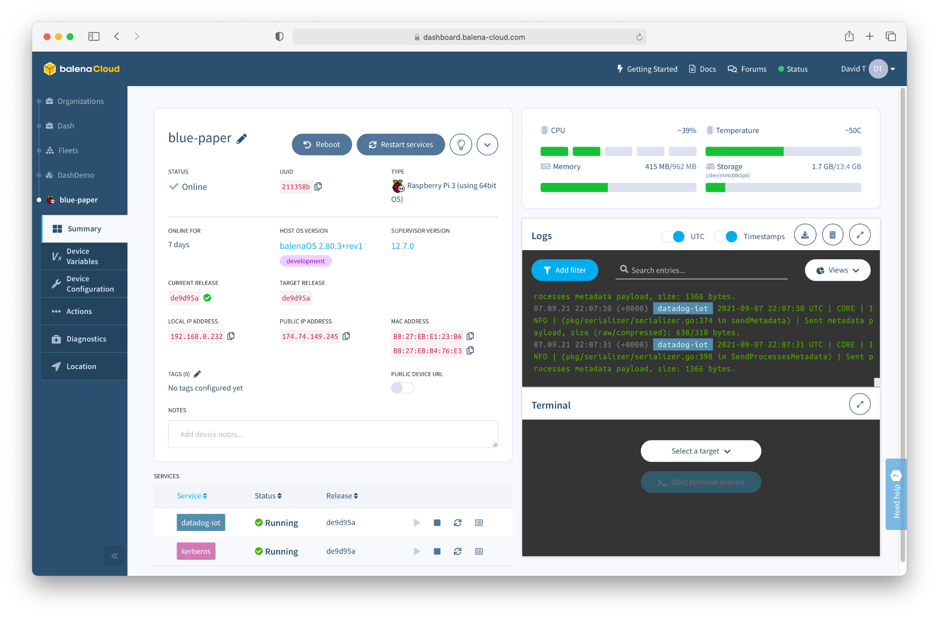

Slide 11
Architecture

Slide 12

balenaOS
Built on Yocto Linux, Optimized for Embedded Devices and IoT Usage
Minimal by design (increased security)
Less RAM / resource requirements
Redundant RootFS partitions
More tolerant of power loss
Minimized SD Card writes
Notes:
Some quick talking points on the Yocto Linux OS

Slide 13

balenaEngine
Container engine built for Embedded and IoT use-cases, based on the Moby Project from Docker
Minimal by design
Less RAM / resource requirements
Delta pulls to save bandwidth
Fault tolerance on container pulls
Notes:
Some quick talking points on the Docker container runtime.

Slide 14

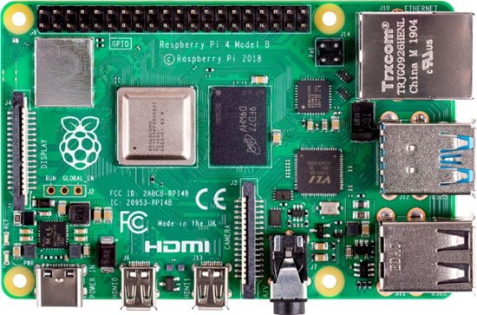
Container1
Container2
Container(n)
Container1
Container2
Container(n)
n

Slide 15
Deploying a Device is Easy

Slide 16
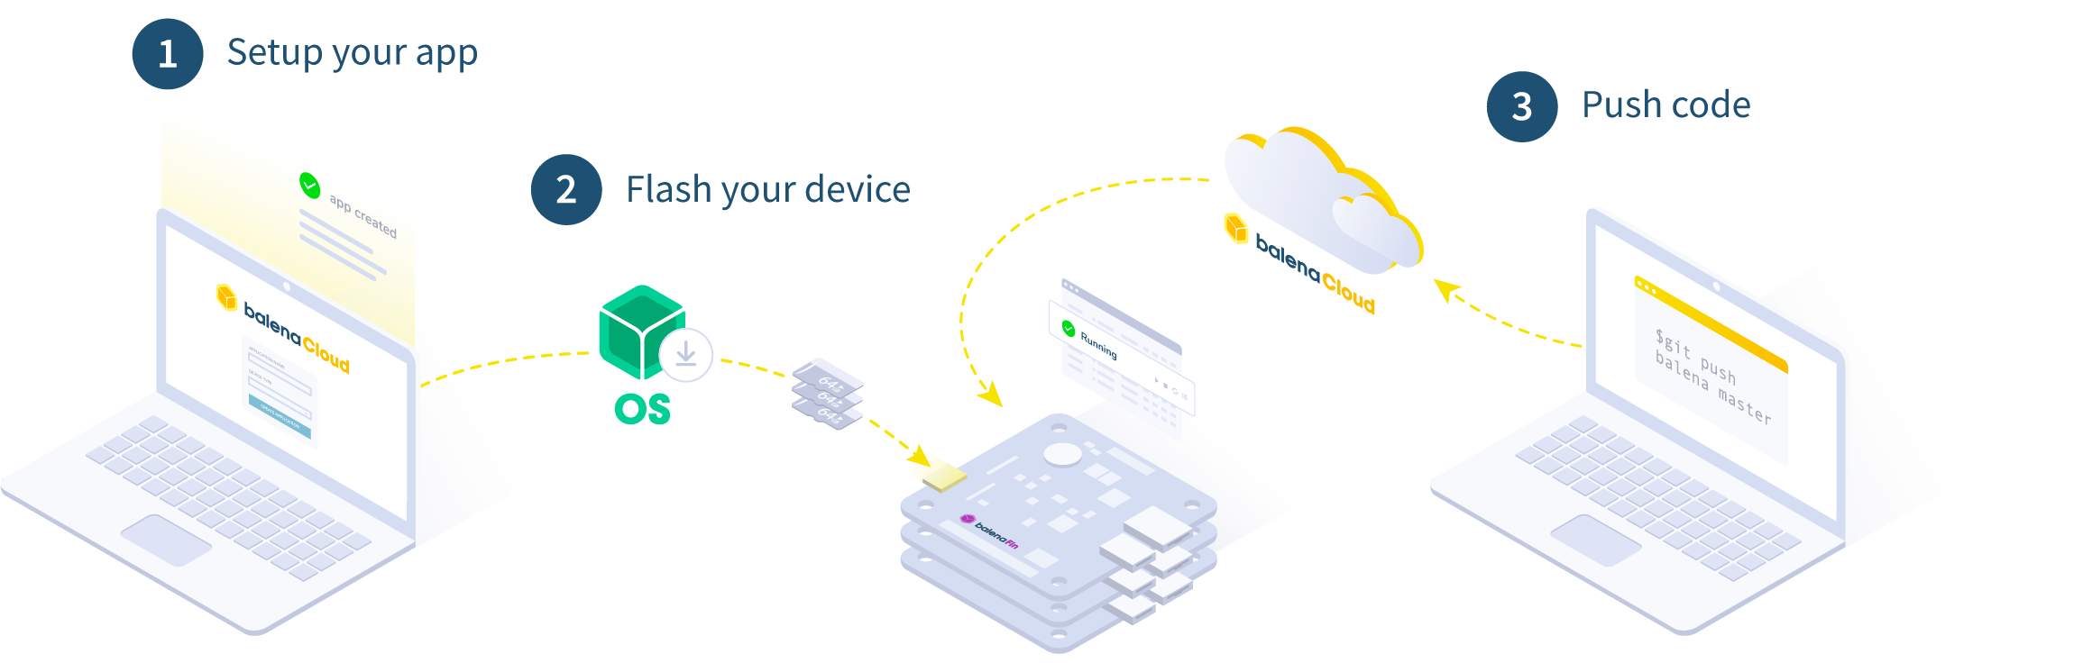
How it works

Slide 17
Getting Started
1
Create an account
2
Create an application
3
Add your device
4
Push your code

Slide 18
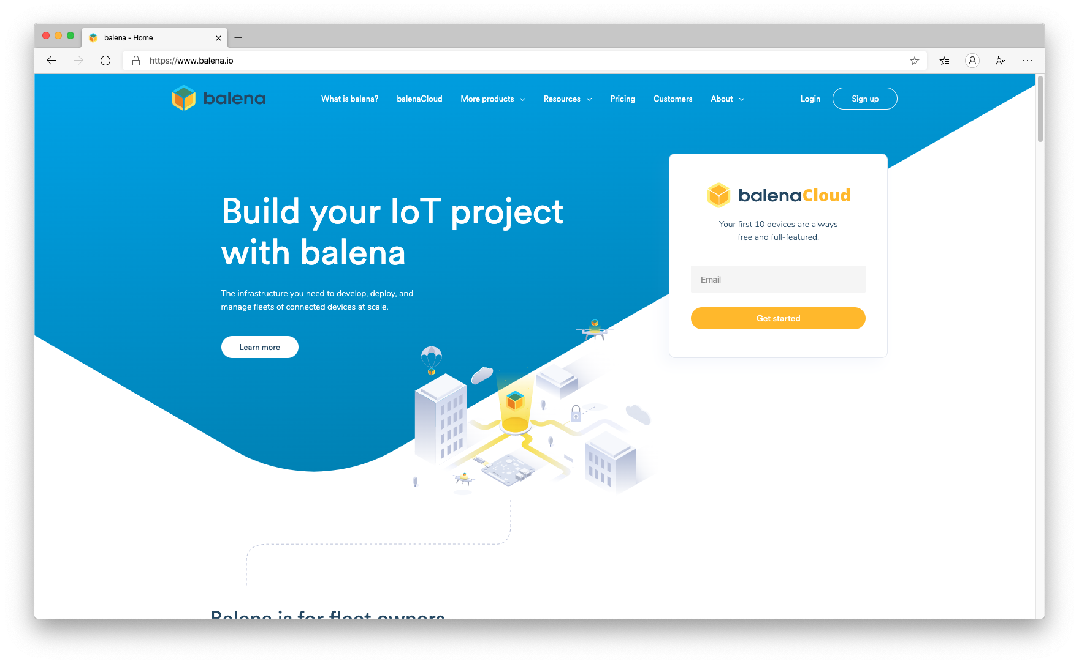

Slide 19
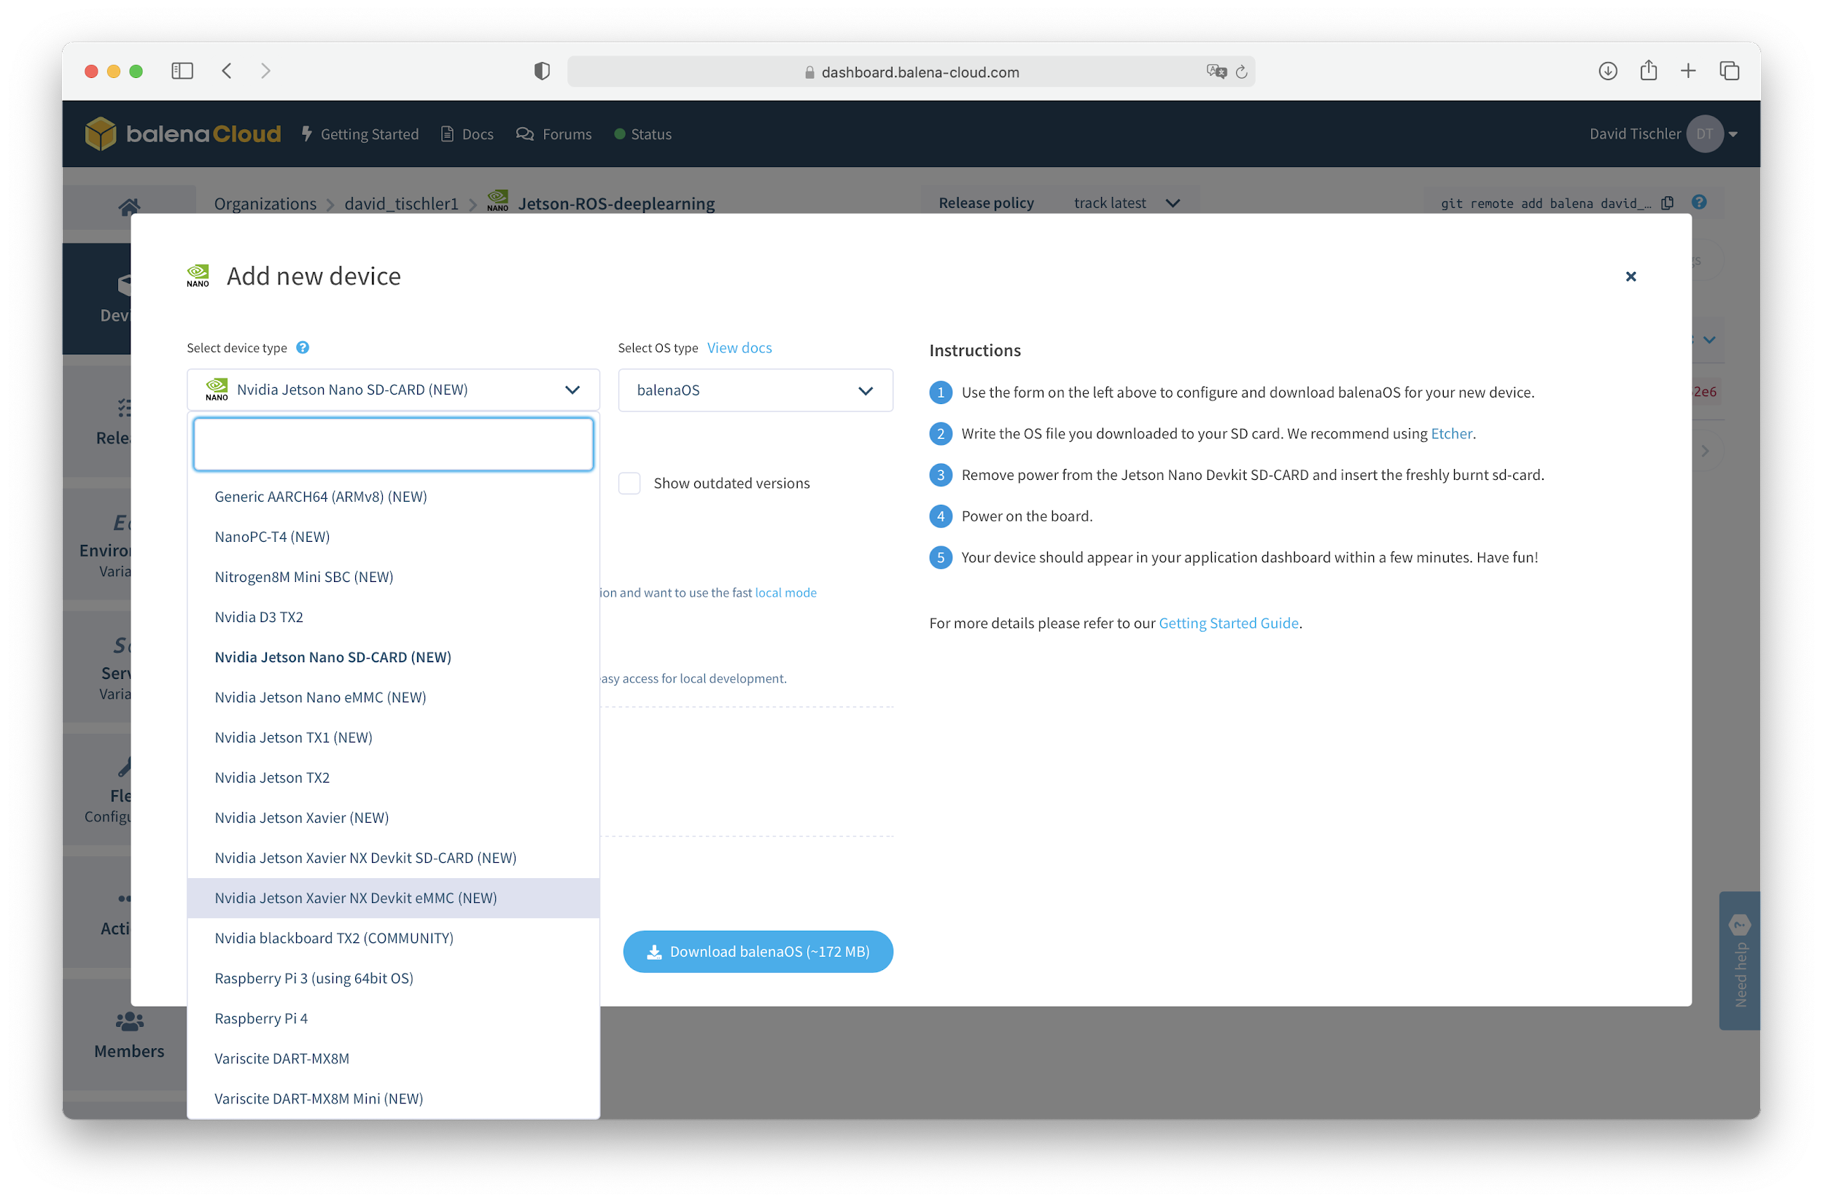

Slide 20


Slide 21
Power Up!

Slide 22
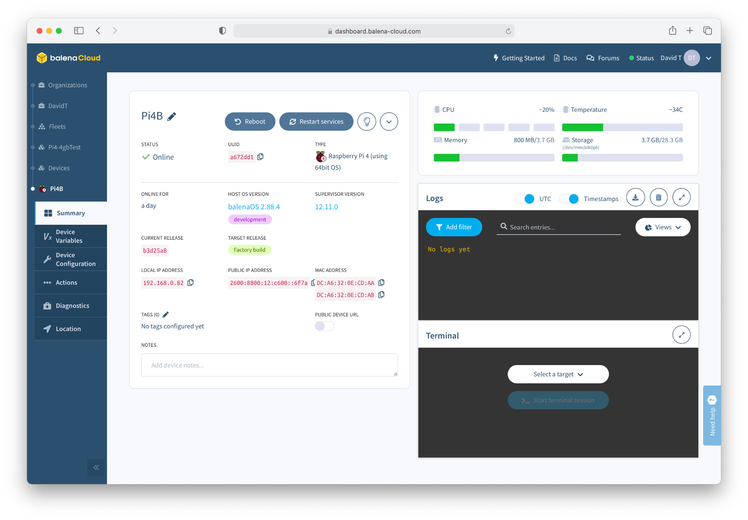

Slide 23
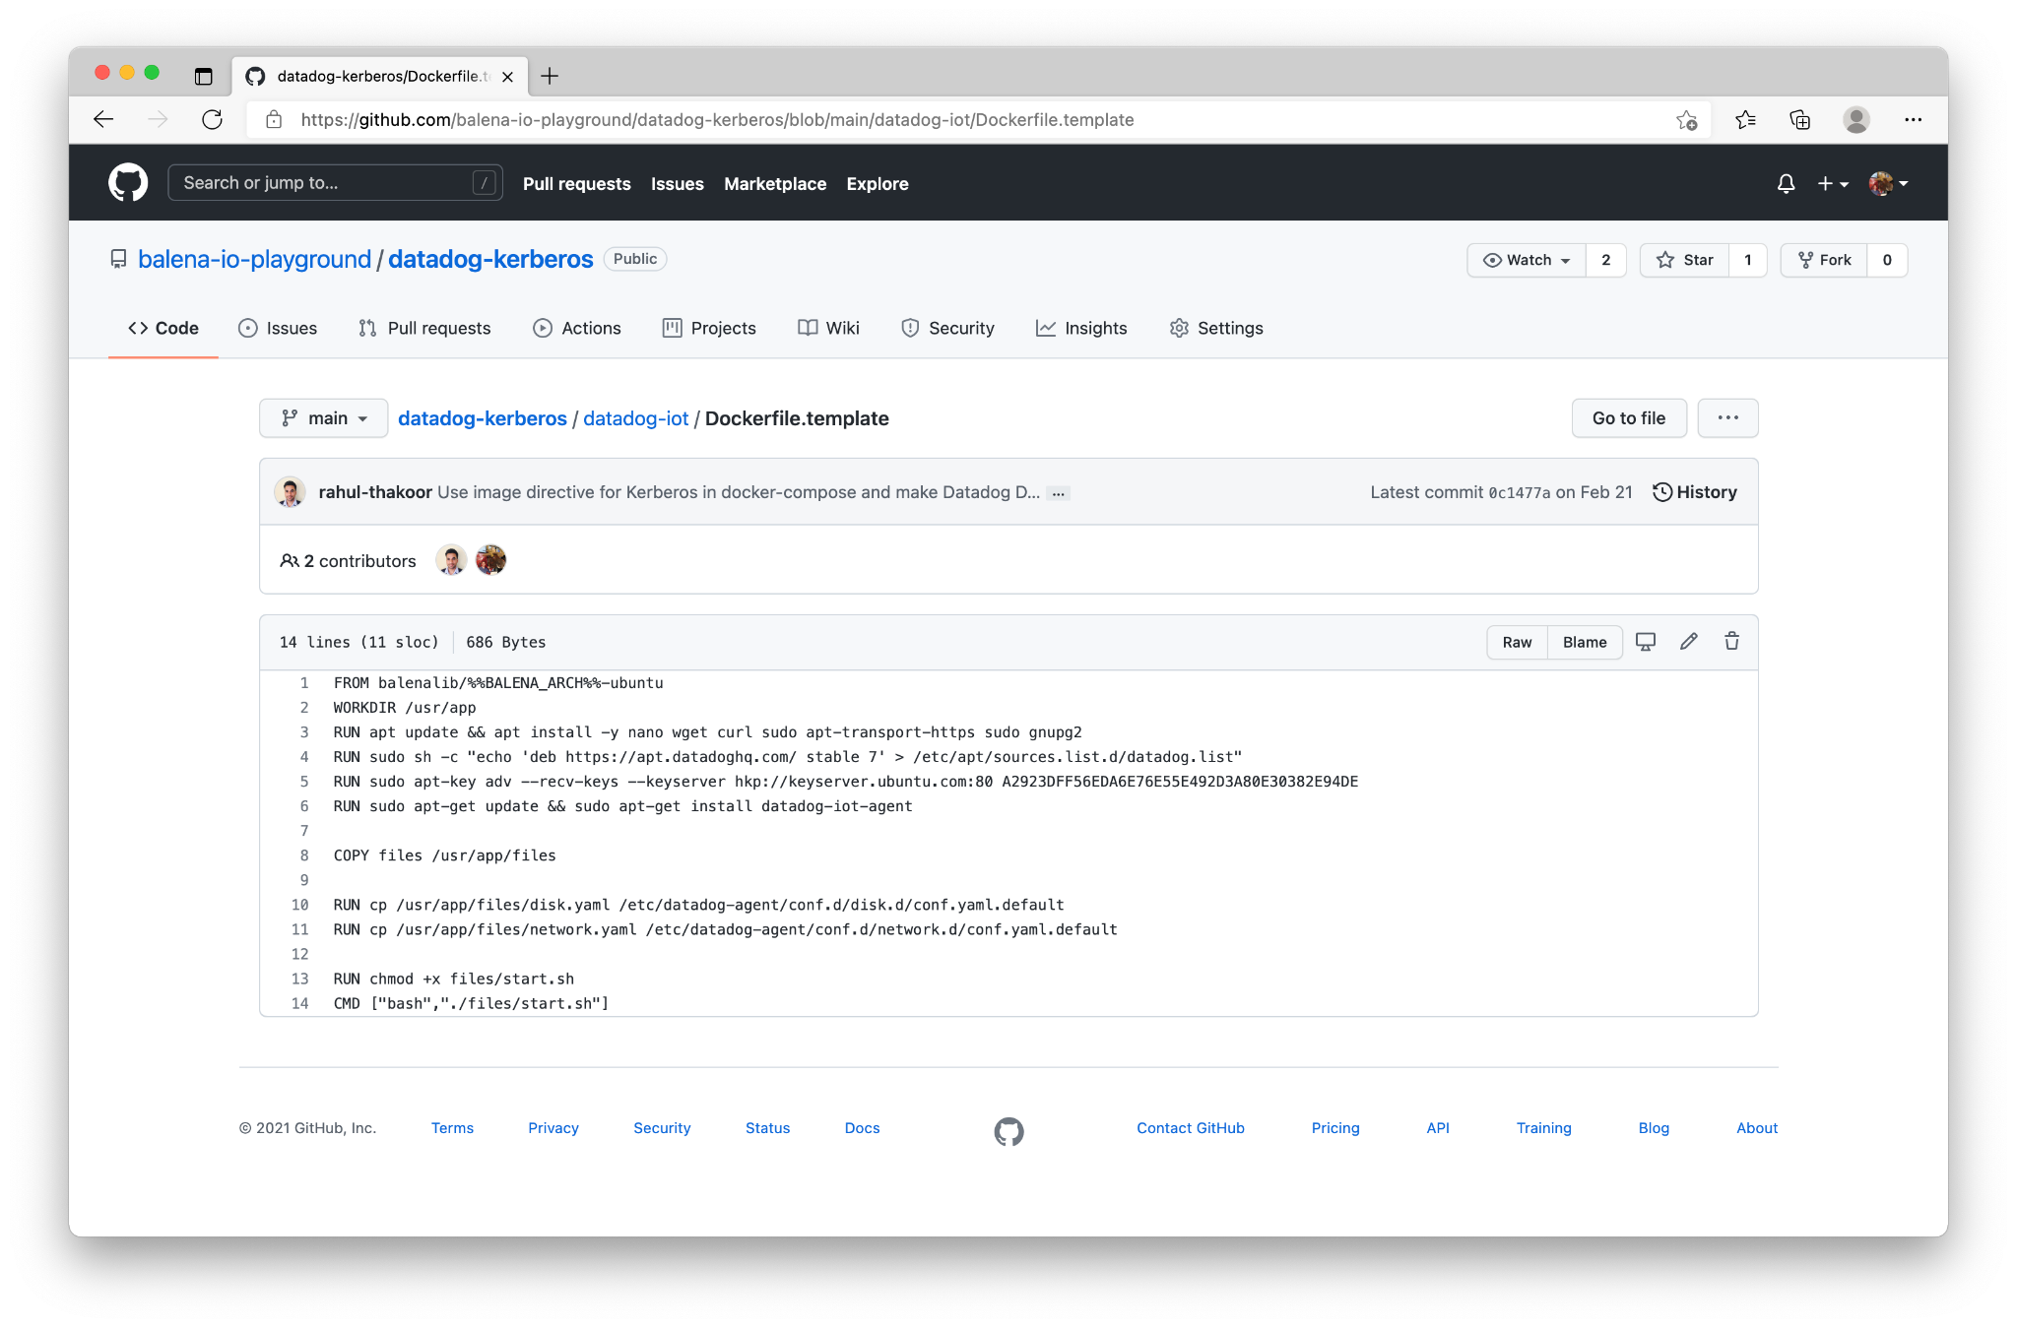

Slide 24
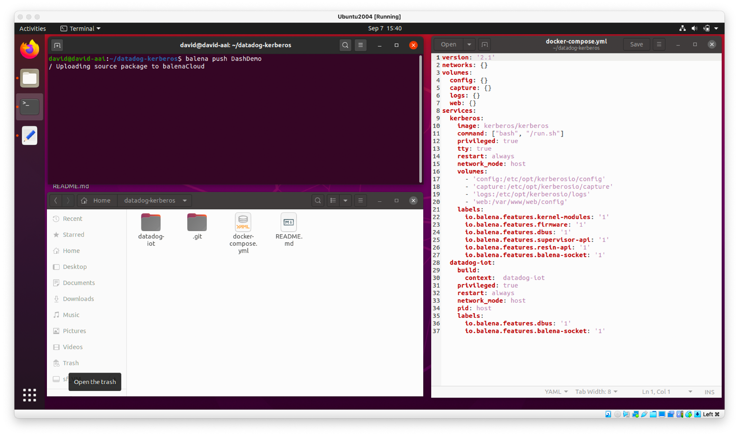
Build and Push Application to Fleet
Use balena CLI to package up application

Slide 25
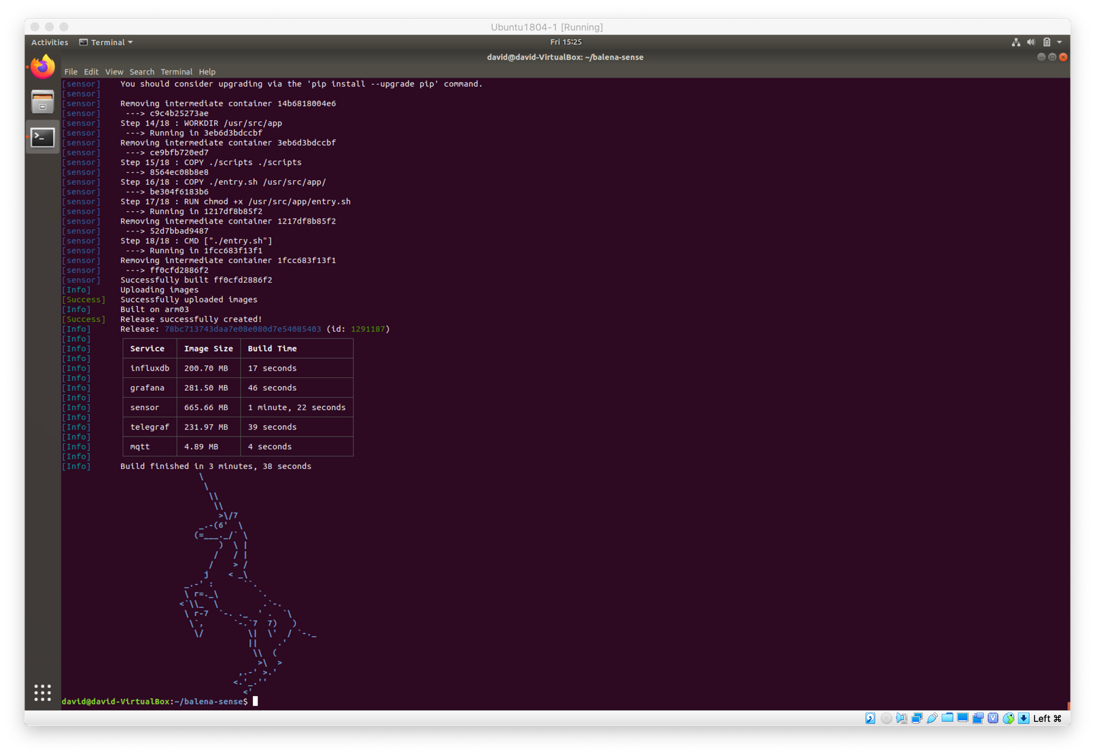
Build and Push Application to Fleet

Slide 26
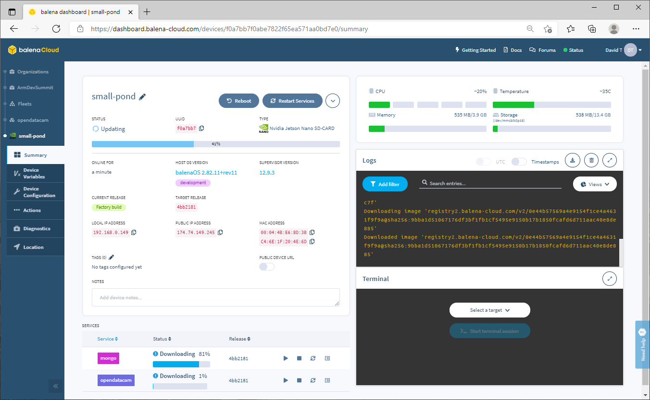

Slide 27
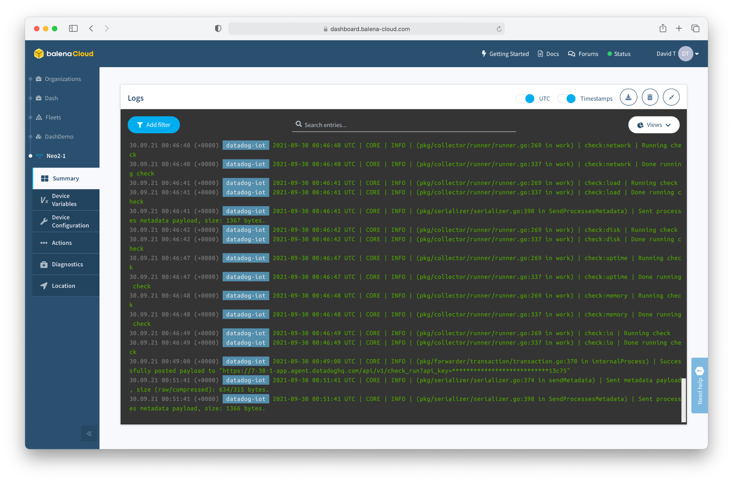

Slide 28
But How Do You Scale?

Slide 29
Let’s think about that workflow for a moment...
We built a container, and loaded it onto a device.
Containers can be updated. Changed. Added to. Improved.
We can push containers onto a device, over the air, no matter where it is located.
The Container(s) are your workload / application.
We deployed to one device. But, we could have deployed to 1,000 devices. Or 10,000.
Or 100,000.
We can manage and interact with the device from the web dashboard.

Slide 30
Let’s think about that workflow for a moment...
We can prototype on cheap / available hardware, but go to production with enterprise-grade hardware.
The container will run the same.
The devices show up in the dashboard.
You can push containers to entire Fleets at a time.

Slide 31
Some Best Practices

Slide 32
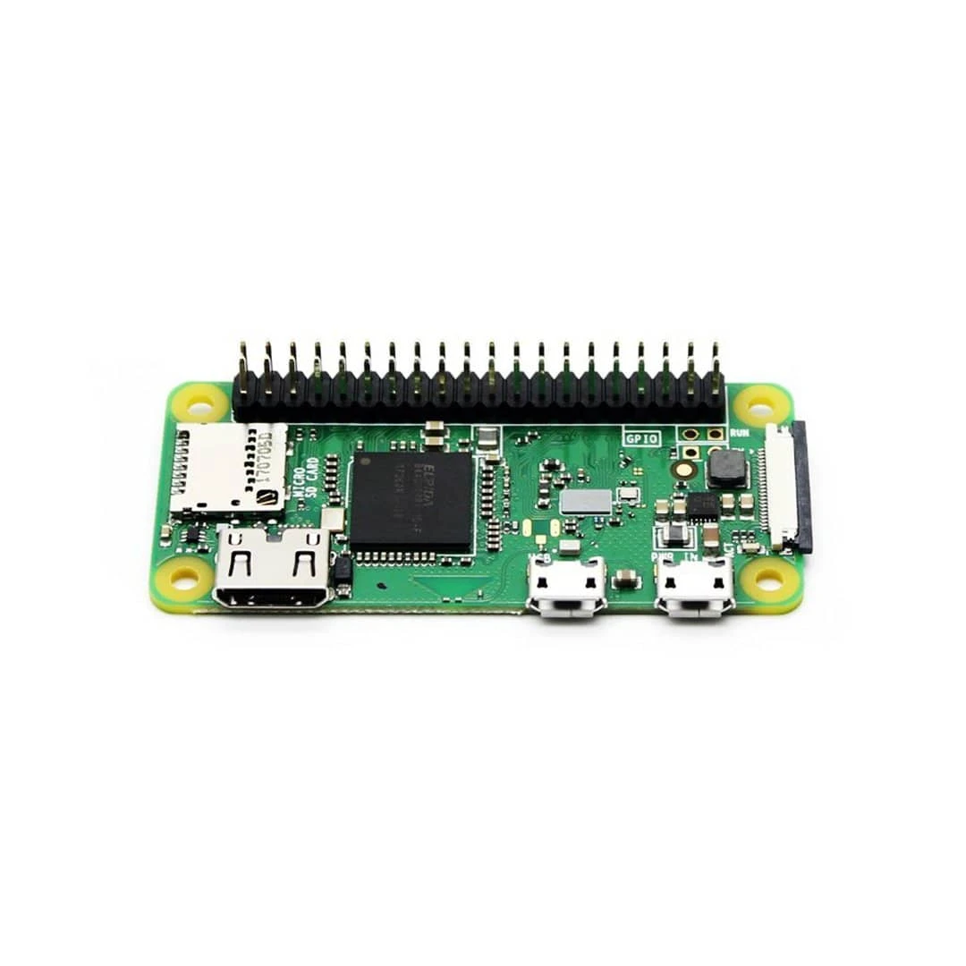
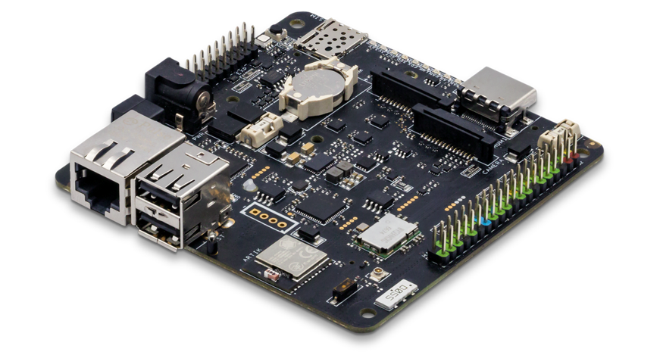
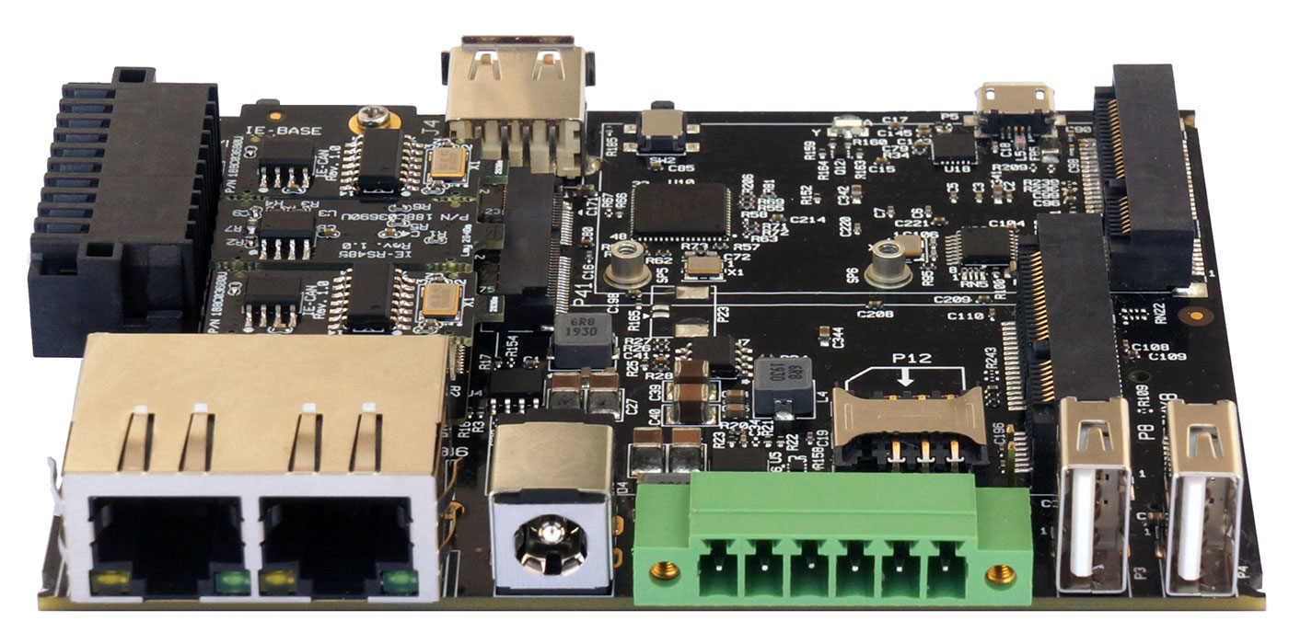
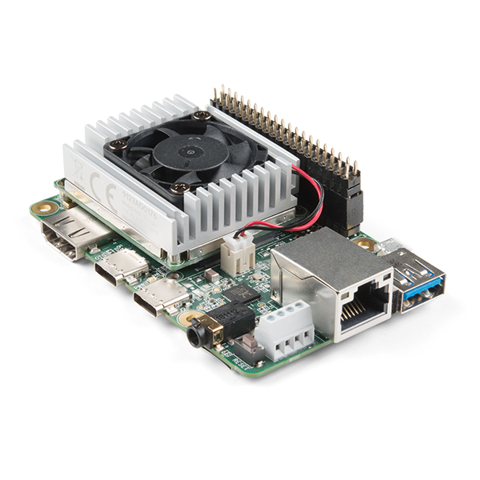
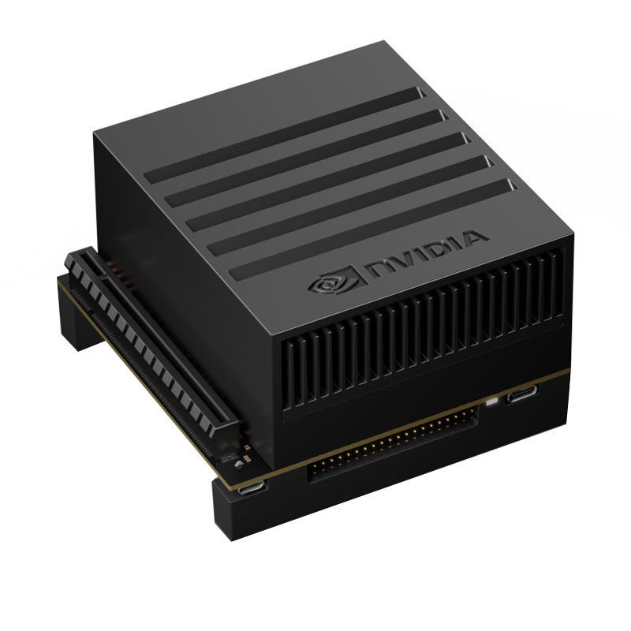
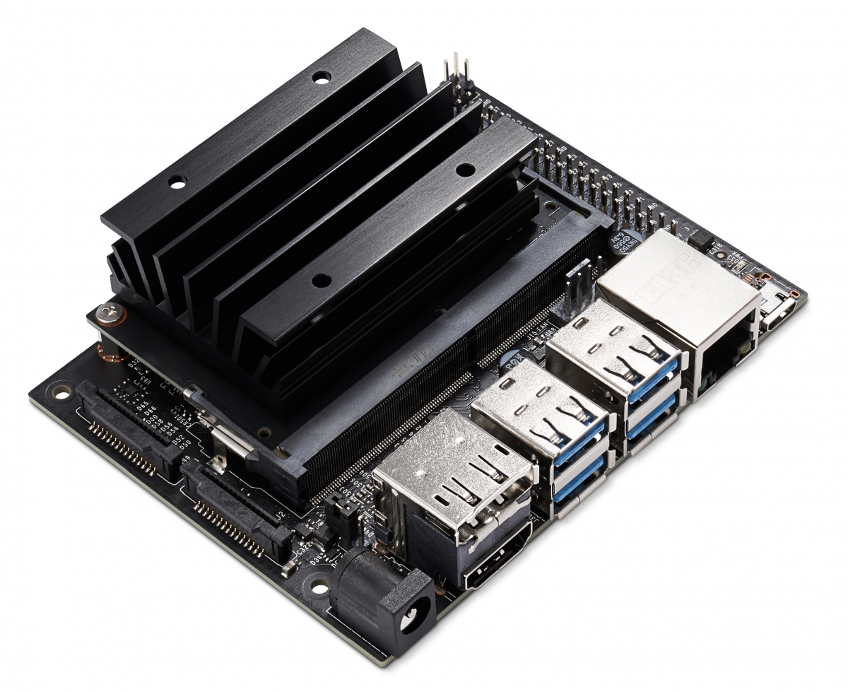
Hardware Selection
vs.
vs.
vs.
vs.

Slide 33
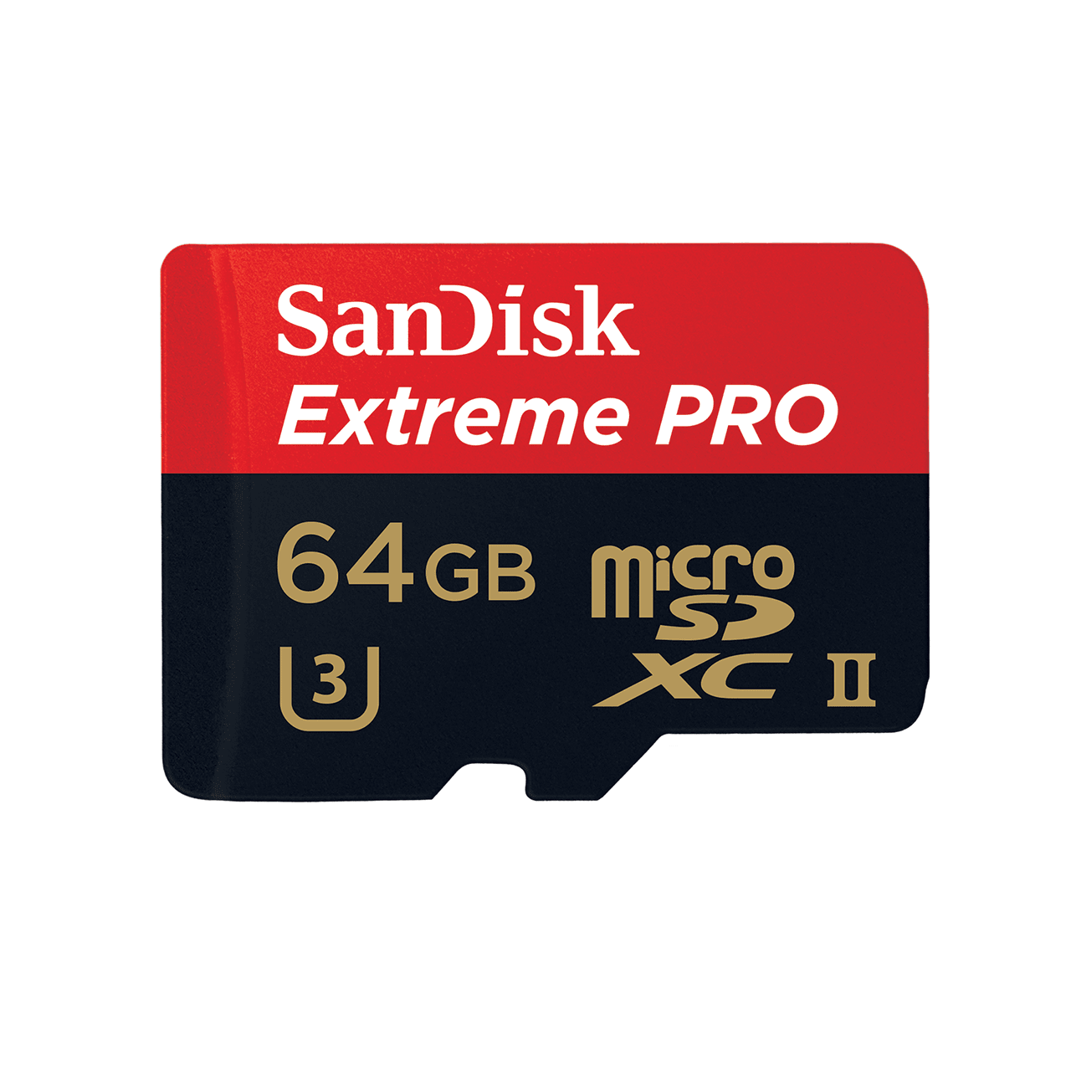

Slide 34



Slide 35

balenaLabs (Things to Try)
Ready made projects, examples, and sample code / containers
Environmental monitor
Kiosk and digital signage
LoRa Gateway
Audio player
Camera and streaming
AI
ROS
and more
Notes:
Some quick talking points on the Yocto Linux OS

Slide 36
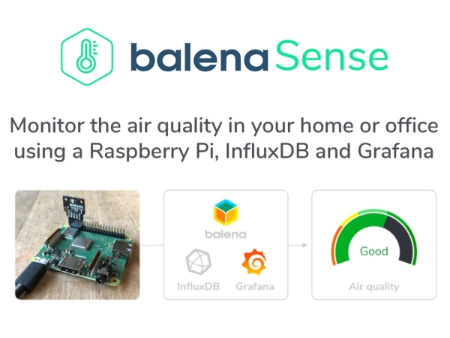
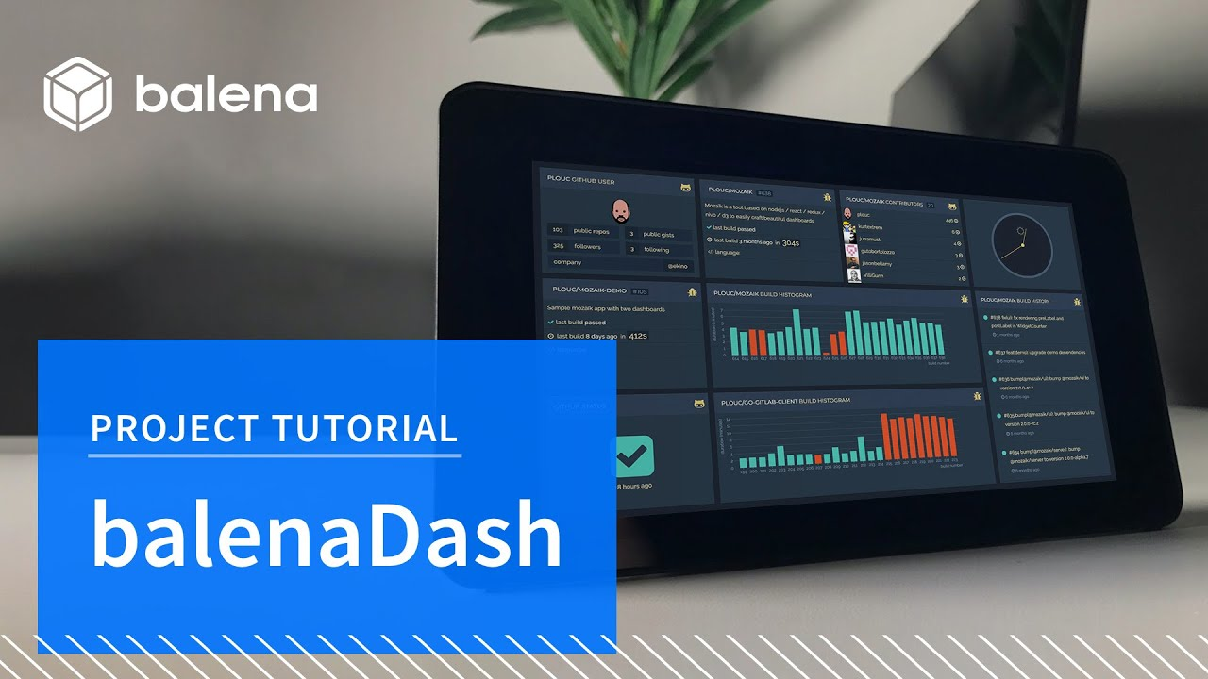
balenaLabs
https://github.com/balena-io-examples
https://github.com/balenalabs
https://github.com/balenalabs-incubator
Notes:
Some quick talking points on the Yocto Linux OS

Slide 37
Questions / Q&A

